Slide 1
Where-to-buy Tech-Onboarding
HC-CARGO 2025

Slide 2
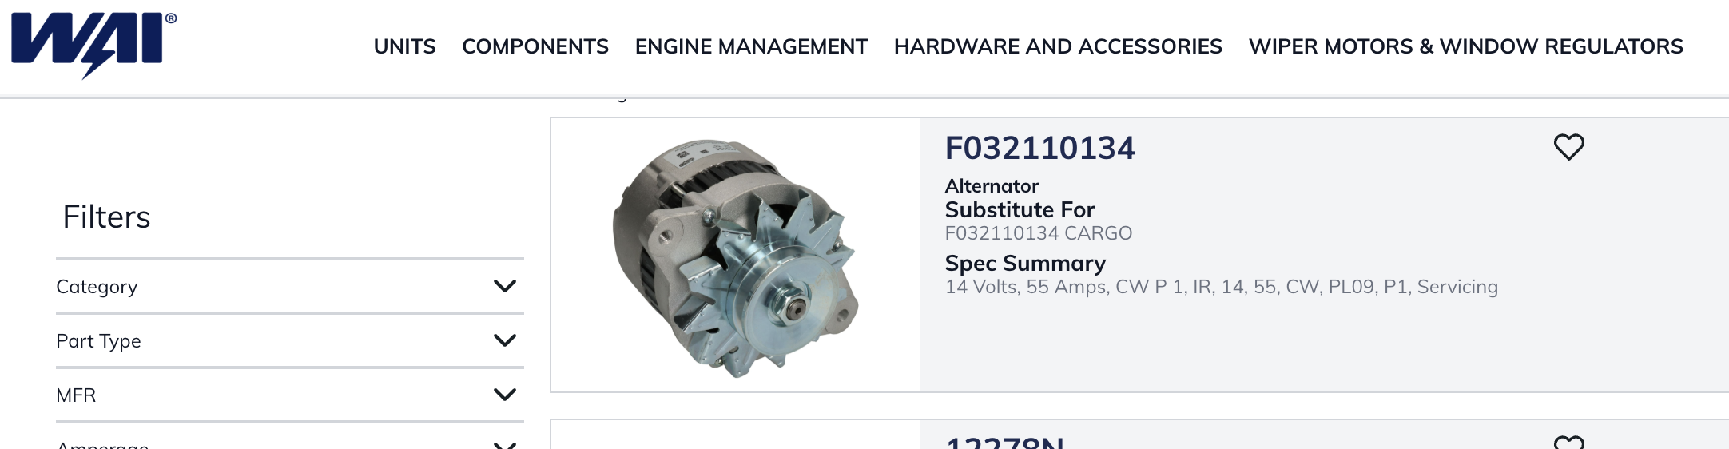
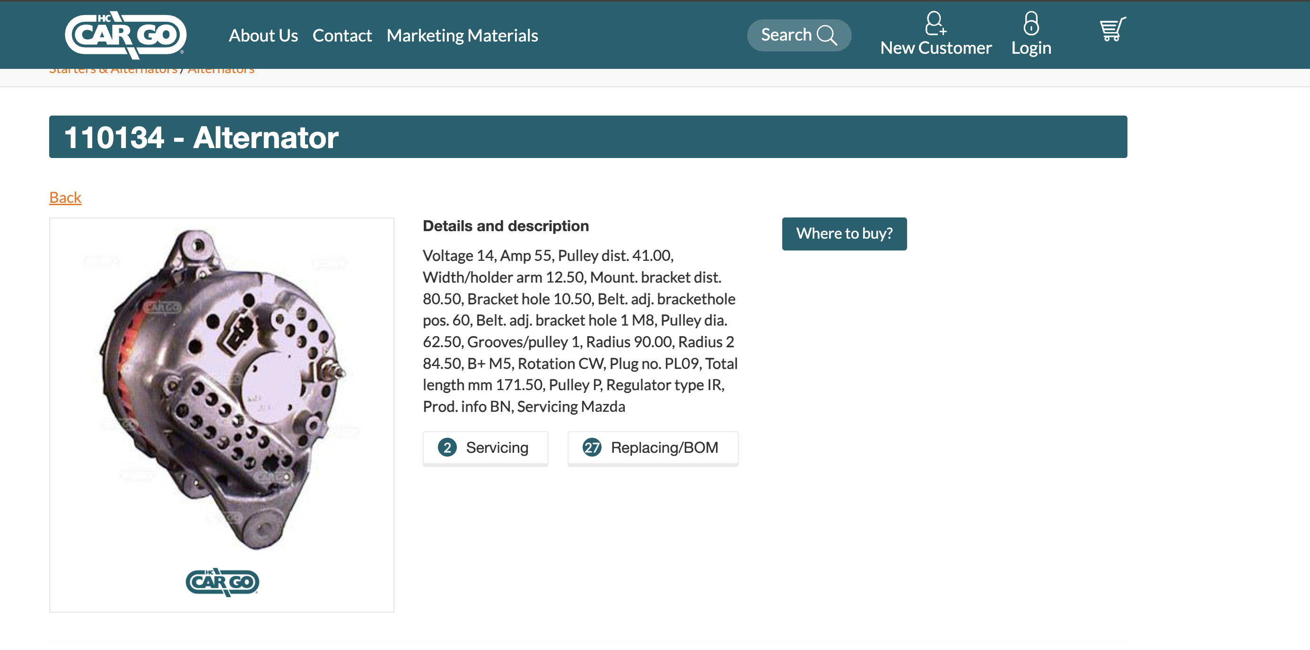
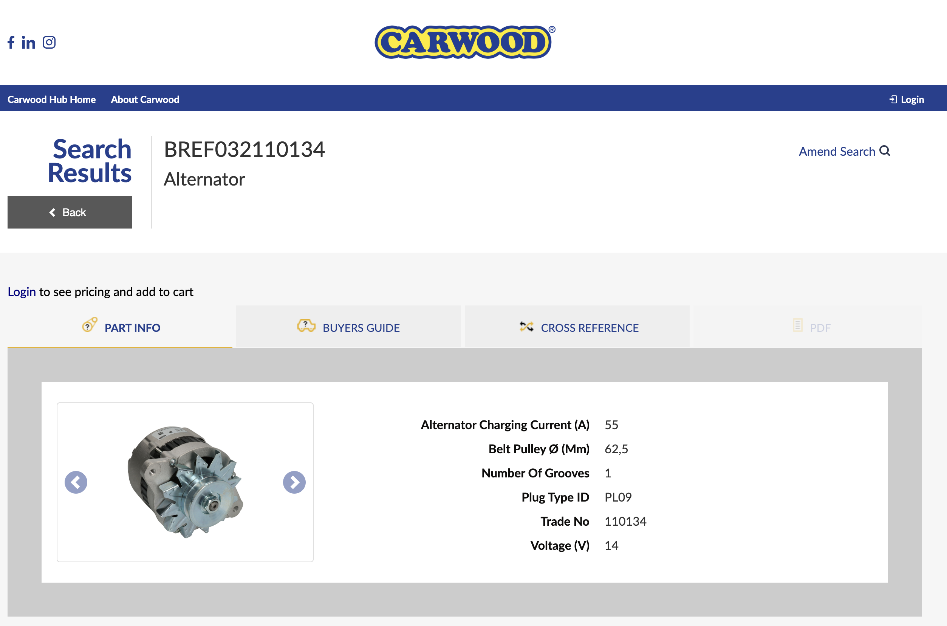
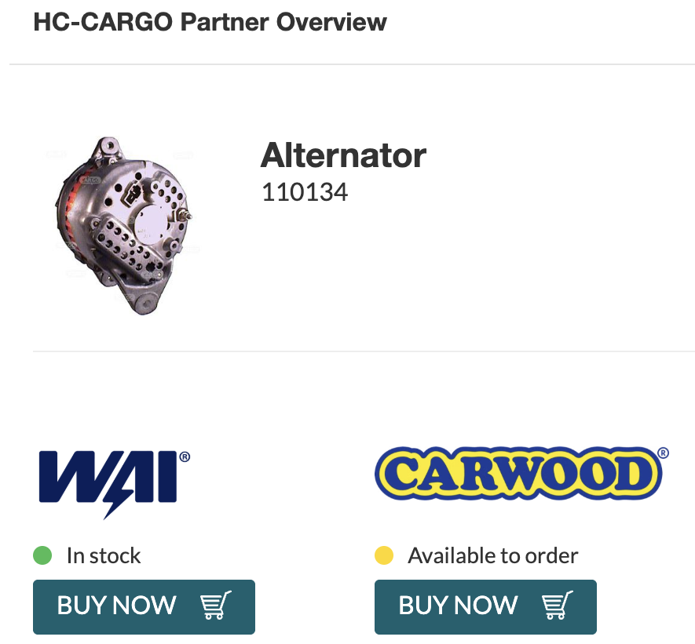
Where-to-buy user journey
1
2

Slide 3








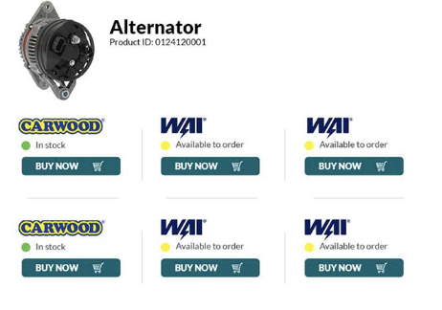

Where-to-buy
Architecture overview
Stock query against
Nexmart API
Daily upload of stock file
Wholesalers
Wholesaler webshops
Redirect to wholesaler product detail page

Slide 4
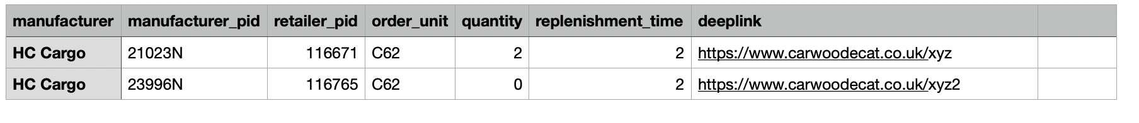
Where-to-buy
Technical onboarding
Step 1: Set up product data and generate stock file
Requirements:
  Distributor must have a webshop with deep links to product detail page (ideally without login)
  Distributor must have up-to-date HC CARGO product data package (i.e. product list, cross-references, images)
  Distributor must be able to cross-reference the HC CARGO product number with the distributor’s product number
  Distributor must be able to generate the where-to-buy stock file with the following data from their ERP/PIM system
    manufacturer_pid = HC CARGO product number
    retailer_pid = Distributor product number cross-referencing the HC CARGO product number
    order_unit = UN/CEFACT format, C62 stands for “1”
    quantity = Stock quantity at distributor
    replenishment_time = Days required for replenishment, ”1” for 1 day
    deeplink = URL to the product detail page

Slide 5
Where-to-buy
Technical onboarding
Step 2: Upload stock file to Nexmart SFTP
Requirements:
    Provision of public key to Nexmart for SFTP setup
    SFTP access details will be provided by Nexmart upon setup
    Upload stock file generated from Step 1 to the SFTP with daily updates
After the stock file has been uploaded, HC CARGO has to update the endpoint and implement the frontend.

